Slide 1
Report on Electrical Characterisation of Thin Film Transistors based on Organic Semiconductor TMTES:PS under X-ray radiation
The batch contains samples with four TMTES:PS ratios: 17:3, 9:1, 19:1 and 39:1. The goal of this experimental research is to calculate the sensitivity per pixel area of the devices and to analyse the dependence of its value on the ratio,

Slide 2
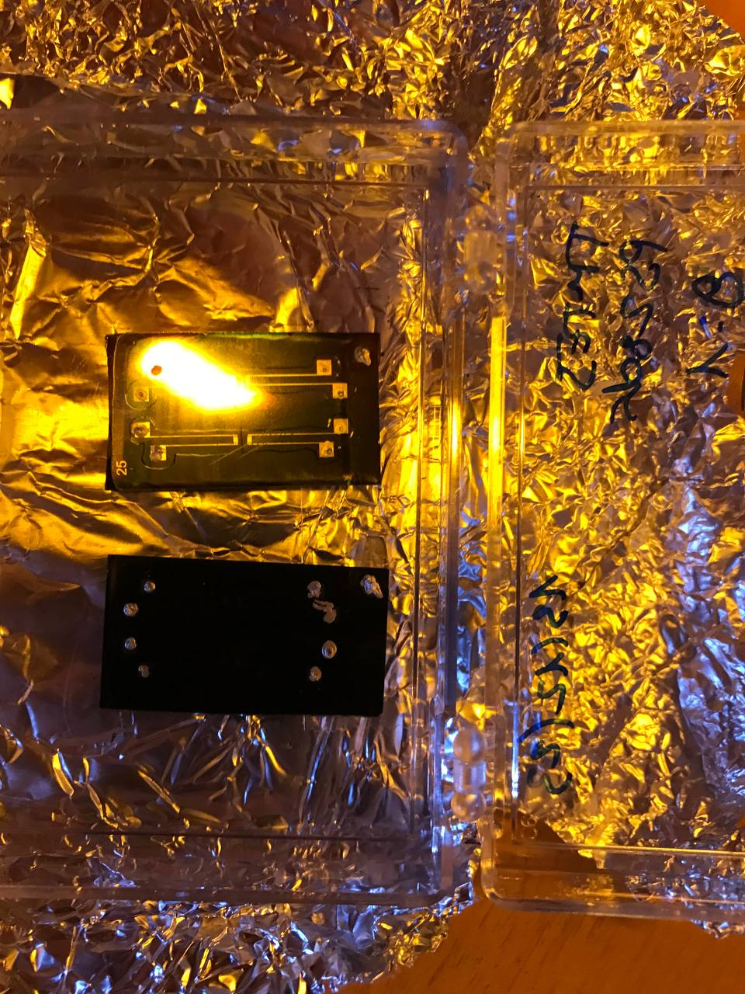
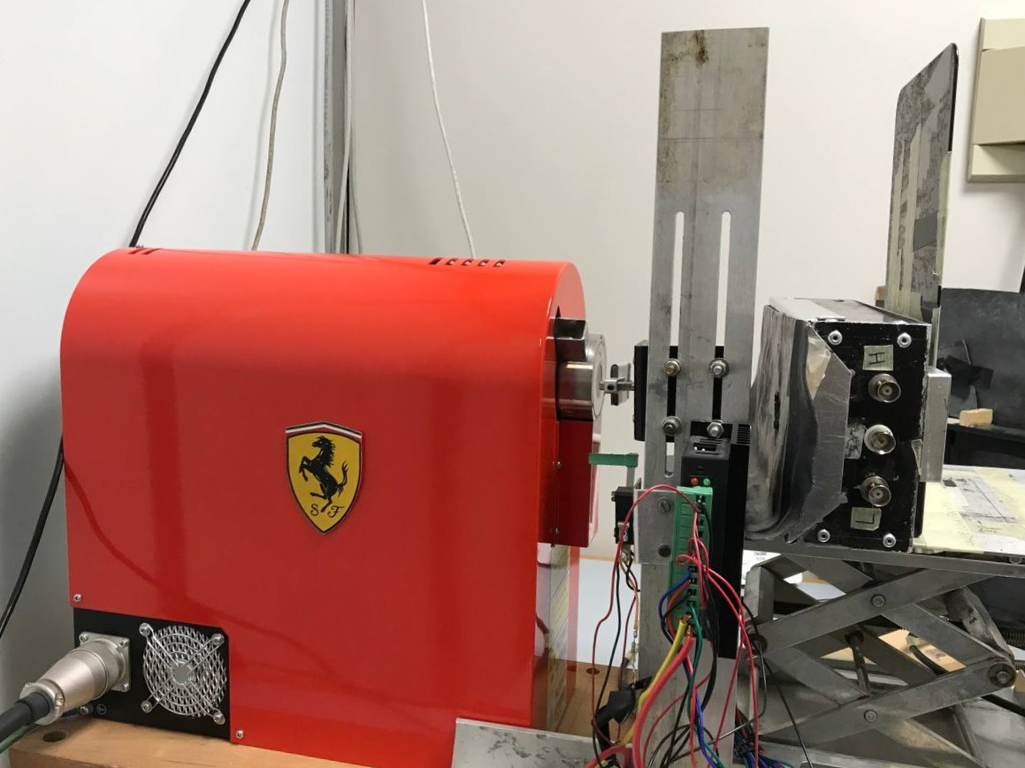
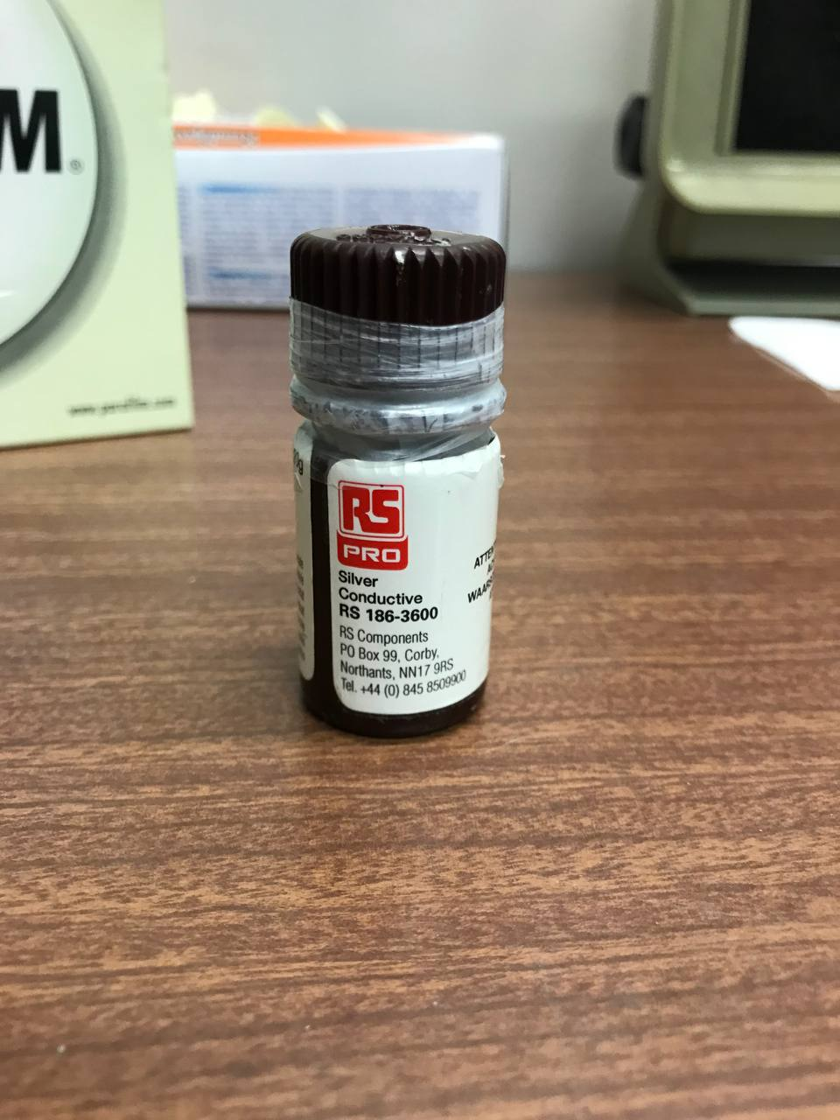
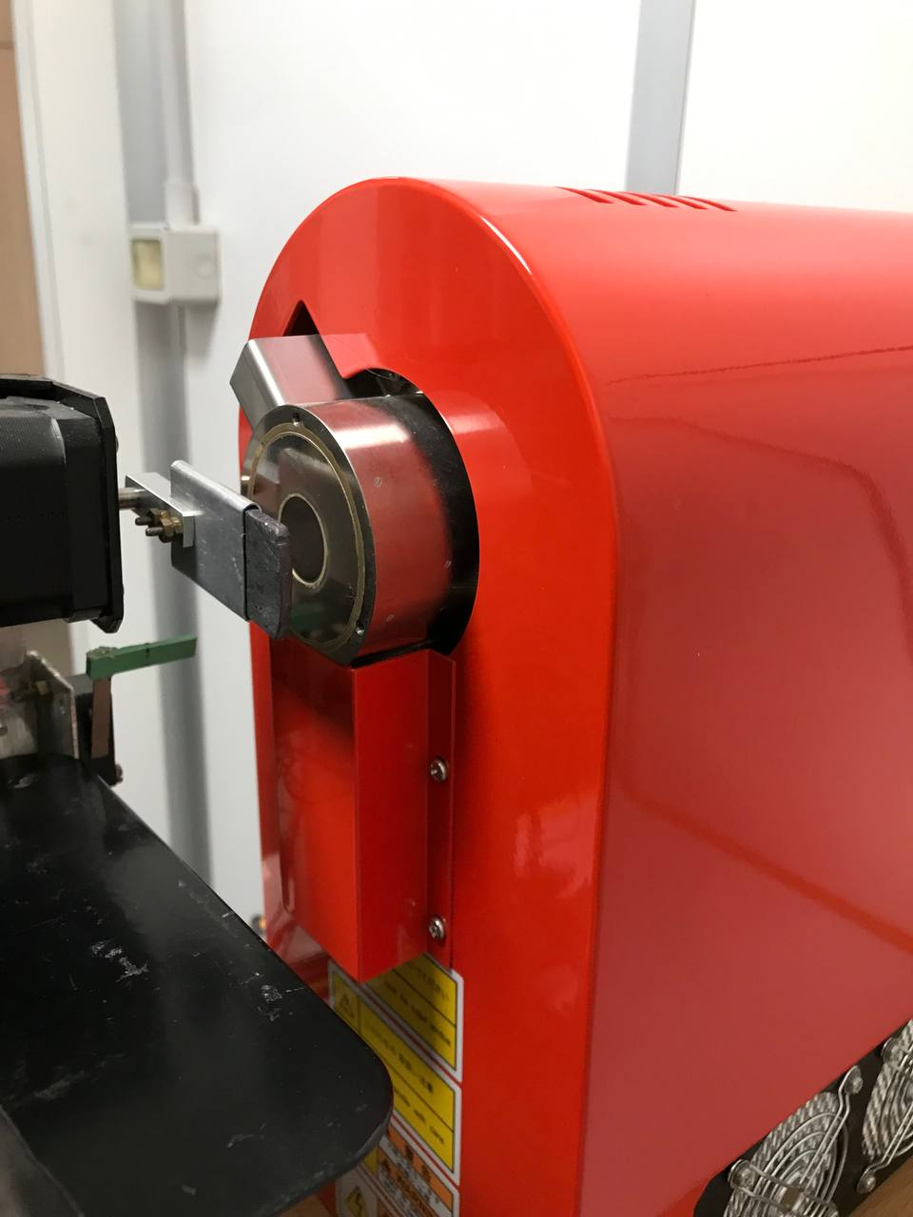
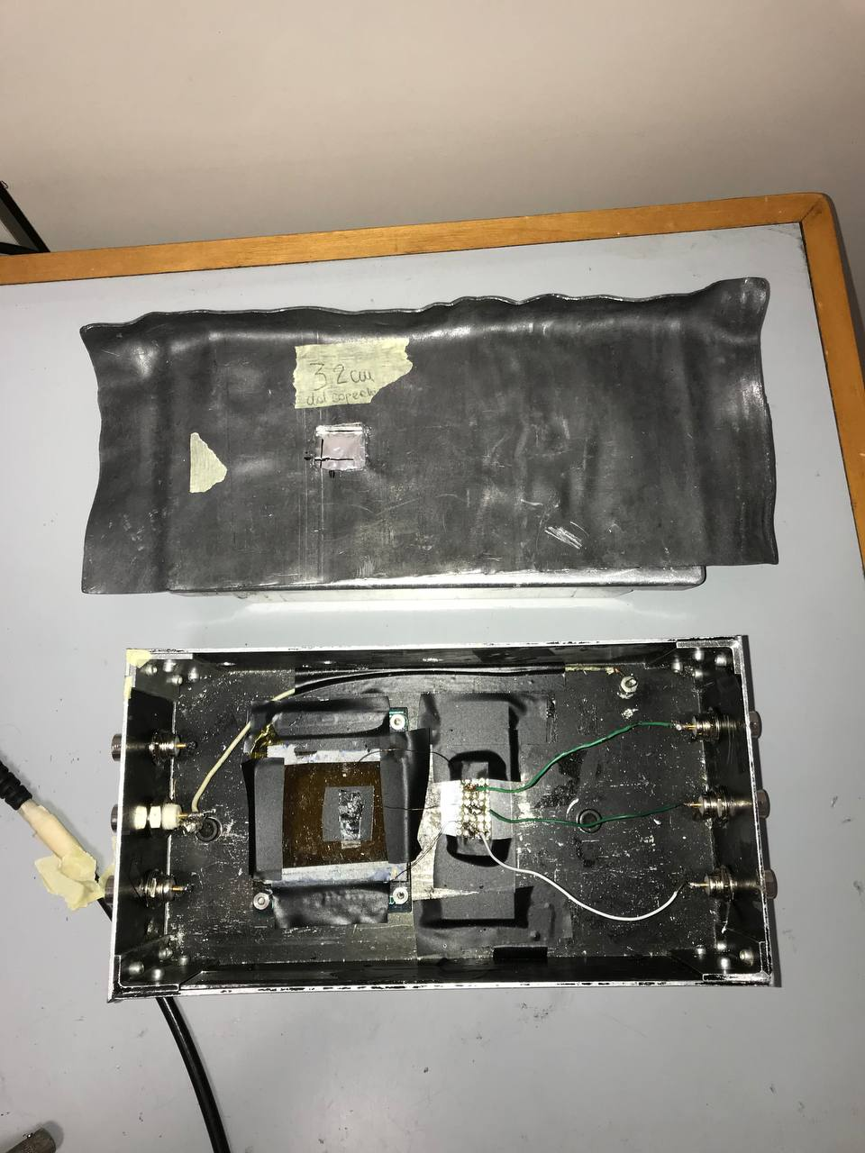
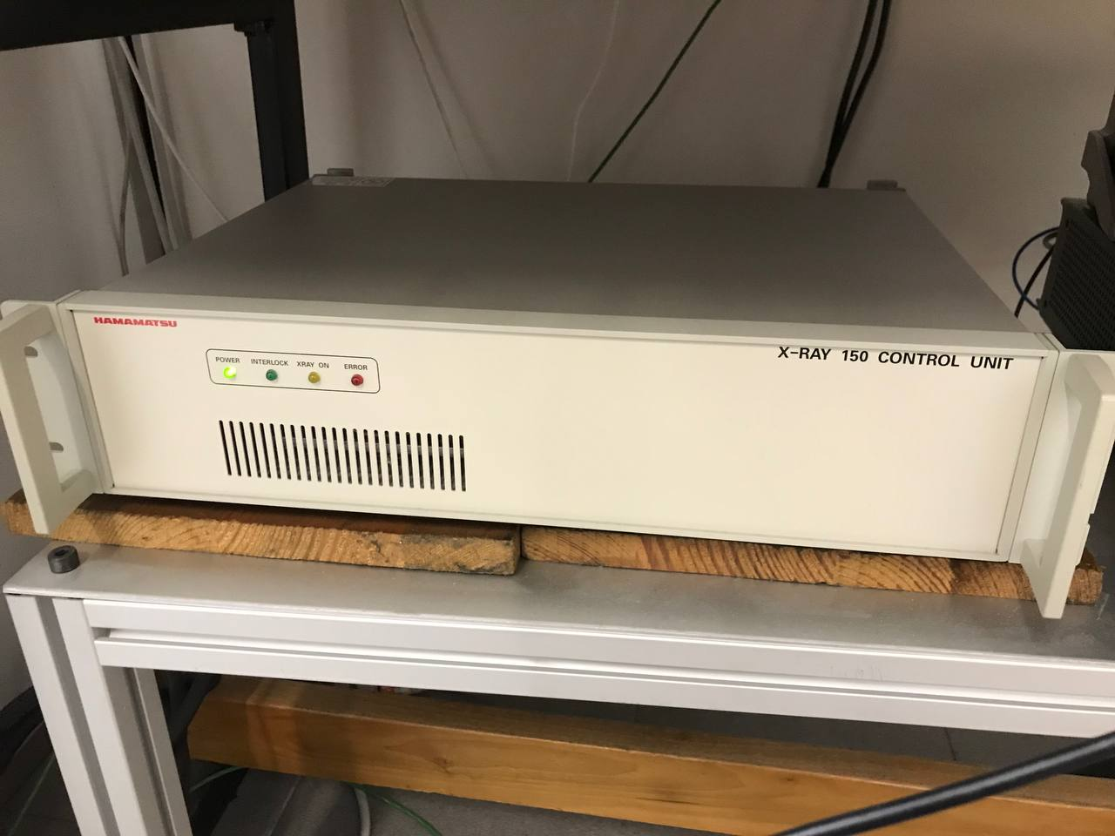
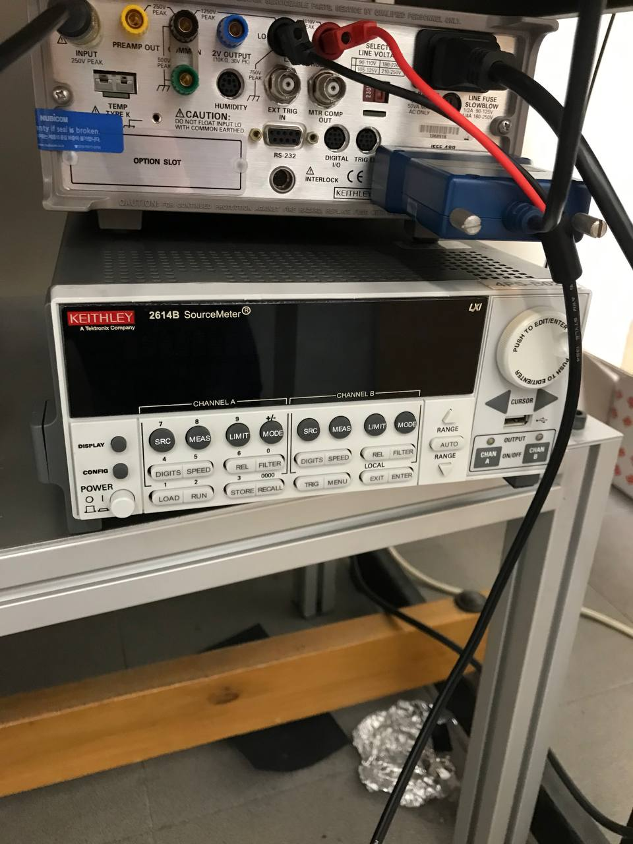
Experimental setup
17 cm

Slide 3
Calibration Plot

Slide 4
Table (Ratios 17:3 and 9:1)
Common features: • W = 2500 um • Thickness of SiO2 insulator layer = 200 nm • No encapsulation
• L = 25 um • Capacitance per unit area Ci = 17.3 nF/cm^2
• Pixel area = 0.00425 cm^2
TMTES:PS | Sample_device | ON/OFF (#*10^3) | SS (V/ec) | Vth (V) | mu (cm^2/(V*s)) | Sensitivity/Area (10^3*uC/(Gy*cm^2))
17:3 | S5_d00 | 190.25 | 0.971±0.016 | 1.20±0.04 | 0.98±0.02 | 3.3±0.7
 | S5_d01 | 28.23 | 0.70±0.03 | 1.18±0.04 | 0.955±0.05 | 3.3±1.2
 | S5_d10 | 2.27 | 1.14±0.02 | 1.77±0.03 | 0.092±0.016 | 3.0±0.2
 | S5_d11 | No data | No data | No data | No data | 6.2±0.3
 | S6_d00 | 116.34 | 0.526±0.006 | 1.41±0.04 | 0.798±0.02 | 2.1±0.4
 | S6_d01 | 1.53 | 0.709±0.010 | 1.51±0.04 | 0.762±0.02 | -
 | S6_d10 | 272.19 | 0.62±0.02 | 1.73±0.04 | 0.755±0.06 | 2.0±0.4
 | S6_d11 | 51.32 | 0.63±0.03 | 1.91±0.10 | 0.80±0.08 | 4.11±0.04
9:1 | S11_d00 | 20.31 | 0.961±0.013 | 2.49±0.04 | 0.547±0.014 | 1.9±0.7
 | S11_d01 | 3.77 | 0.71±0.02 | 1.87±0.03 | 0.519±0.04 | 3.3±0.4
 | S11_d10 | 1.95 | 1.214±0.009 | 2.72±0.05 | 0.0549±0.006 | -
 | S11_d11 | 0.40 | 0.985±0.015 | 7.63±0.8 | 0.020±0.015 | -
 | S12_d00 | 58.68 | 0.638±0.002 | 1.76±0.03 | 0.650±0.005 | 1.74±0.12
 | S12_d01 | 1.02 | 1.379±0.017 | 1.66±0.04 | 0.0185±0.009 | -
 | S12_d10 | 16.14 | 0.582±0.005 | 1.69±0.04 | 0.727±0.014 | 3.9±0.2
 | S12_d11 | 12.07 | 0.571±0.007 | 1.91±0.04 | 0.707±0.02 | 2.7±0.2

Slide 5
Table (Ratios 19:1 and 39:1)
Common features: • W = 2500 um • Thickness of SiO2 insulator layer = 200 nm • No encapsulation
• L = 25 um • Capacitance per unit area Ci = 17.3 nF/cm^2
• Pixel area = 0.00425 cm^2
TMTES:PS | Sample_device | ON/OFF (#*10^3) | SS (V/ec) | Vth (V) | mu (cm^2/(V*s)) | Sensitivity/Area (10^3*uC/(Gy*cm^2))
19:1 | S17_d00 | 22.32 | 2.05±0.06 | 5.83±0.11 | 0.331±0.014 | - (Negstive peaks)
 | S17_d01 | 22.10 | 2.03±0.05 | 5.27±0.12 | 0.388±0.013 | - (Negstive peaks)
 | S17_d10 | 9.42 | 2.441±0.006 | 5.88±0.09 | 0.376±0.001 | - (Negstive peaks)
 | S17_d11 | 10.39 | 2.49±0.080 | 6.01±0.12 | 0.340±0.012 | - (Negstive peaks)
 | S18_d00 | 98.24 | 1.32±0.05 | 5.62±0.11 | 0.456±0.03 | - (Negstive peaks)
 | S18_d01 | 51.79 | 1.56±0.05 | 5.50±0.11 | 0.471±0.02 | - (Negstive peaks)
 | S18_d10 | 44.13 | 2.00±0.07 | 6.16±0.12 | 0.412±0.017 | - (Negstive peaks)
 | S18_d11 | No data | No data | No data | No data | - (Negstive peaks)
39:1 | S23_d00 | 4.71 | 3.19±0.02 | 8.43±0.14 | 0.315±0.002 | - (Negstive peaks)
 | S23_d01 | 22.17 | 3.39±0.04 | 8.95±0.15 | 0.305±0.003 | - (Negstive peaks)
 | S23_d10 | 24.44 | 2.525±0.019 | 8.57±0.09 | 0.279±0.003 | - (Negstive peaks)
 | S23_d11 | 24.25 | 3.05±0.05 | 8.55±0.13 | 0.286±0.005 | - (Negstive peaks)
 | S24_d00 | 6.65 | 3.22±0.03 | 11.82±0.11 | 0.230±0.003 | - (Negstive peaks)
 | S24_d01 | 0.29 | 3.76±0.06 | 14.12±0.17 | 0.000180±0.004 | - (Negstive peaks)
 | S24_d10 | 11.98 | 4.76±0.05 | 16.40±0.09 | 0.1609±0.002 | - (Negstive peaks)
 | S24_d11 | 7.65 | 3.69±0.04 | 12.82±0.10 | 0.195±0.003 | - (Negstive peaks)

Slide 6
Ratio 17:3
Sample5_device00
Sample5_device01
Sample5_device10
Sample5_device11
Sample6_device00
Sample6_device01
Sample6_device10
Sample6_device11

Slide 7
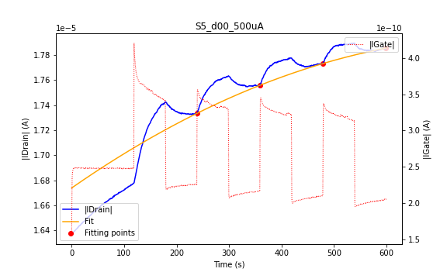
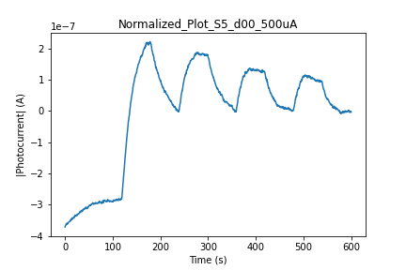
Sample5_device00
3.3±0.7
|IDrain| peaks look normal when radiation is ON.

Slide 8
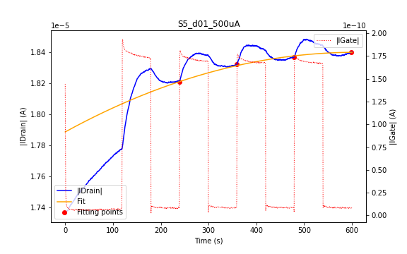
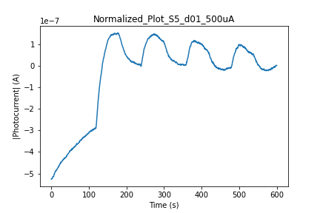
Sample5_device01
3.3±1.2
When radiation is ON, the |IDrain| starts to slightly decrease after reaching its highest value.

Slide 9
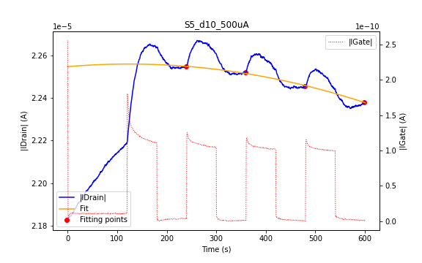
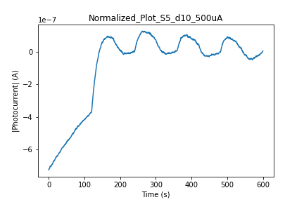
Sample5_device10
3.0±0.2
The transfer characteristics slightly change before and after the X-ray measurements.
When radiation is ON, the |IDrain| starts to decrease after reaching its highest value.

Slide 10
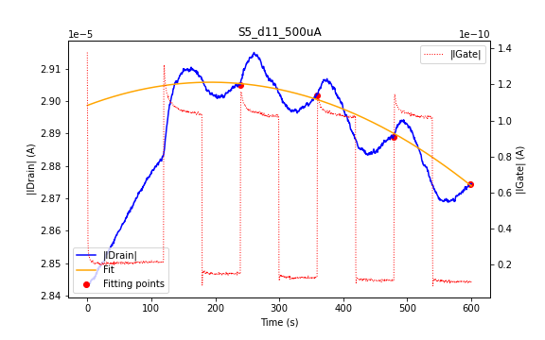
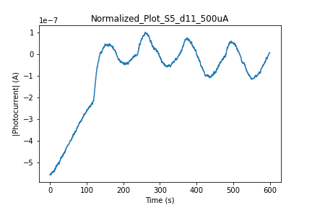
Sample5_device11
6.2±0.3
The transfer characteristics before the X-ray measurements barely differ from the ones after the radiation.
Here it is clearly seen that after some seconds of radiation, |IDrain| starts decrease even though the radiation is still ON. Such tendency is more evident for the last peaks (3rd and 4th). To briefly mention this form in subsequent devices, such anomaly was called as “decreasing peaks”.

Slide 11
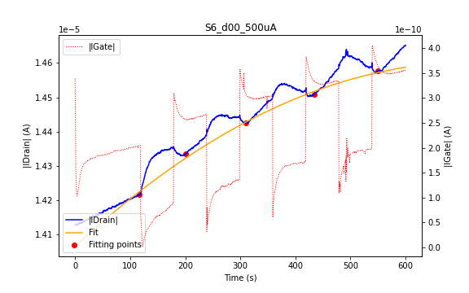
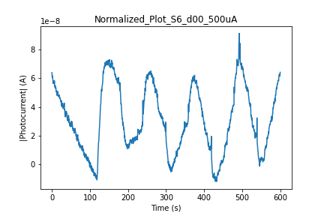
Sample6_device00
2.1±0.4
The transfer characteristics are noticeably altered before the X-ray measurements (the trfSat curve is shifted towards positive VGate) decreasing the SS and ON/OFF ratio.
While the first peak seems normal, the subsequent “decreasing peaks” are present.

Slide 12
Sample6_device01
-
The X-ray measurements of this device were not finished, but it is seen that here the |IDrain| peaks are positive.

Slide 13
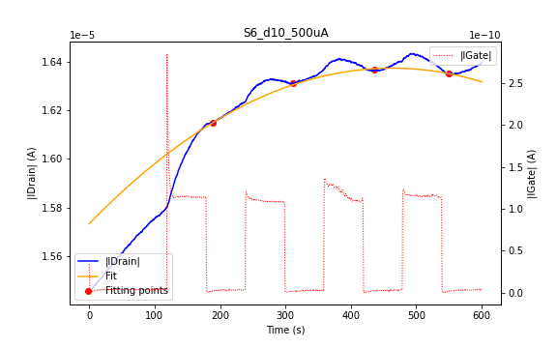
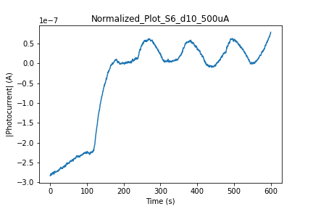
Sample6_devie10
2.0±0.4
The transfer characteristics are barely altered before the X-ray measurements.
While the first peak seems normal, the subsequent “decreasing peaks” are present.

Slide 14
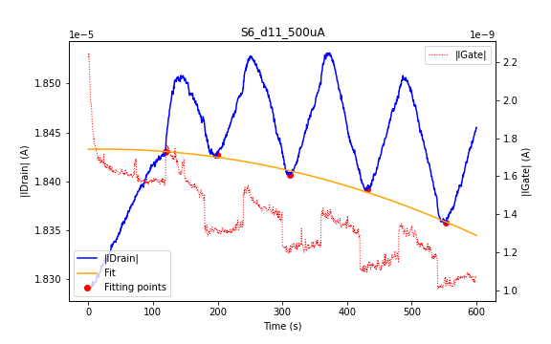
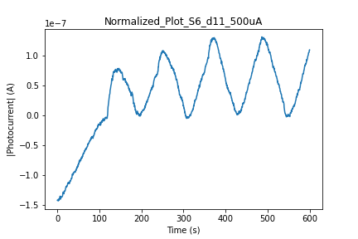
Sample6_device11
4.11±0.04
The transfer characteristics are noticeably altered before the X-ray measurements (the trfSat curve is shifted towards +VGate) with decreasing SS and ON/OFF ratio.
Here the “decreasing peaks” are exposed even at the first peak with intensifying tendency. At the last peak, |IDrain| starts to decrease even at the beginning of radiation.

Slide 15
Ratio 9:1
Sample11_device00
Sample11_device01
Sample11_device10
Sample11_device11
Sample12_device00
Sample12_device01
Sample12_device10
Sample12_device11

Slide 16
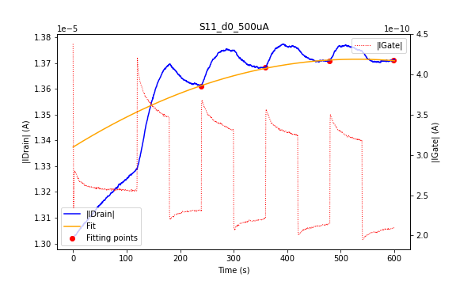
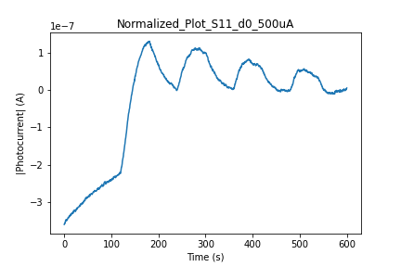
Sample11_device00
1.9±0.7
Transfer characteristics barely changes before and after radiation.
During X-ray measurements, the height of peaks gradually decreases, the “decreasing peaks” effect is not so strong as for Sample6.

Slide 17
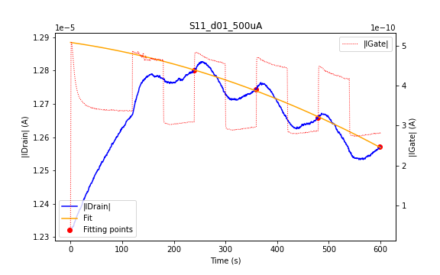
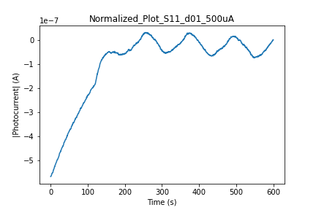
Sample11_device01
3.3±0.4
The transfer characteristics slightly change before the X-ray measurements.
During the X-ray measrements, the “decreasing peaks” are present.
The photocurrent was calculated as the difference between the max and min values of |IDrain| at each peak. Still, the sensitivity value cannot be reliable.

Slide 18
Sample11_device10
-
The transfer characteristics slightly change before the X-ray measurements.
Here |IDrain| starts to decrease when the radiation is ON. Such anomalous effect is referred as “negative peaks”.

Slide 19
Sample11_device11
-
The transfer characteristics noticeably change before the X-ray measurements (the hysteresis is increased).
he response of the device to the radiation is barely seen, but it seems to be “negative peaks”.

Slide 20
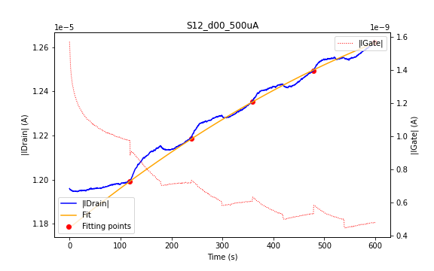
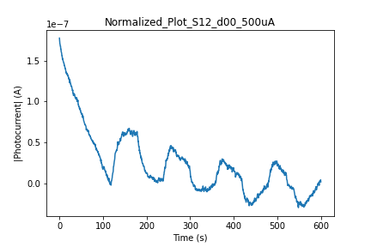
Sample12_device00
1.74±0.12
Transfer characteristics before and after the X-ray measurements are altered (the trfSat curve is shifted to the right).
During the X-ray measrements, the “decreasing peaks” are present.

Slide 21
Sample12_device01
-
Transfer characteristics of the device are weakly changed before and after the X-ray measurements.
When the radiation is ON, “negative peaks” are present.

Slide 22
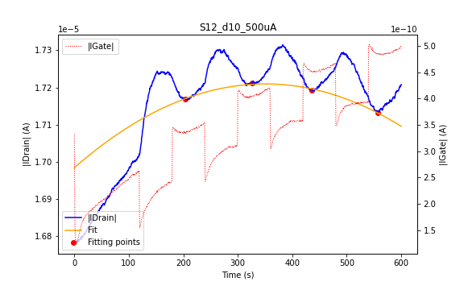
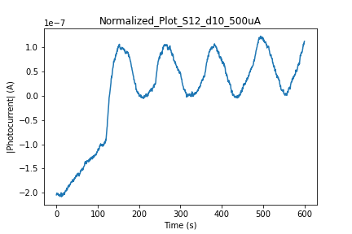
Sample12_device10
3.9±0.2
Transfer characteristics of the device are weakly changed before and after the X-ray measurements.
When the radiation is ON, the first peak looks normal, but in subsequent peaks the “decreasing peaks” are present.

Slide 23
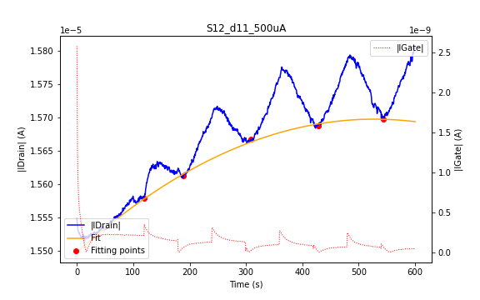
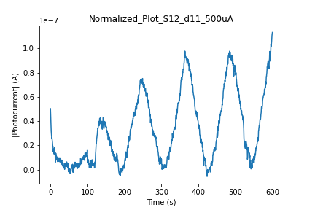
Sample12_device11
2.7±0.2
The transfer characteristics are quite altered before and after the X-ray measurements (the curves are shifted to the right and the SS decreases).
When the radiation is ON, the “decreasing peaks” completely turn to “negative peaks”, when |IDrain| decreases at X-rays.
The photocurrent was calculated as the difference between the max and min values of |IDrain| at each peak. Still, the sensitivity value cannot be reliable.

Slide 24
Sample12_device11

Slide 25
Ratio 19:1
Sample17_device00
Sample17_device01
Sample17_device10
Sample17_device11
Sample18_device00
Sample18_device01
Sample18_device10
Sample18_device11

Slide 26
Sample17_device00
-
The transfer characteristics are not strongly changed before the X-ray measurements.
When the radiation is ON, “negative peaks” are present.

Slide 27
Sample17_device00

Slide 28
Sample17_device01
-
The transfer characteristics are noticeably altered before the X-ray measurements (the trfSat curve is shifted to the right, the hysteresis is increased).
When the radiation is ON, “negative peaks” are present.

Slide 29
Sample17_device10
-
The transfer characteristics are noticeably altered before the X-ray measurements (the trfSat curve is shifted to the right, the hysteresis is increased).
When the radiation is ON, “negative peaks” are present.

Slide 30
Sample17_device11
-
The transfer characteristics are noticeably altered before the X-ray measurements (the trfSat curve is shifted to the right, the hysteresis is increased).
When the radiation is ON, “negative peaks” are present.

Slide 31
Sample18_device00
-
The transfer characteristics are slightly changed before the X-ray measurements (the trfSat curve is shifted to the right).
When the radiation is ON, “negative peaks” are present.

Slide 32
Sample18_device01
-
The transfer characteristics are weakly changed before and after the X-ray measurements (the trfSat curve is shifted to the right).
When the radiation is ON, “negative peaks” are present.

Slide 33
Sample18_device10
-
The transfer characteristics are weakly changed before and after the X-ray measurements.
When the radiation is ON, “negative peaks” are present.

Slide 34
Sample18_device11
-
The transfer characteristics in saturation regime before the X-ray measurements are quite flat.
When the radiation is ON, “negative peaks” are present.

Slide 35
Ratio 39:1
Sample23_device00
Sample23_device01
Sample23_device10
Sample23_device10
Sample24_device00
Sample24_device01
Sample24_device10
Sample24_device11

Slide 36
Sample23_device00
-
SHORT CIRCUIT of IGate.

Slide 37
Sample23_device01
-
The transfer characteristics slightly differ before the X-ray measurements.
When the radiation is ON, “negative peaks” are present.

Slide 38
Sample23_device10
-
The transfer characteristics slightly differ before the X-ray measurements.
When the radiation is ON, “negative peaks” are present.

Slide 39
Sample23_device11
-
The transfer characteristics slightly differ before the X-ray measurements.
When the radiation is ON, “negative peaks” are present.

Slide 40
Sample24_device00
-
The transfer characteristics slightly differ before the X-ray measurements.
When the radiation is ON, “negative peaks” are present.

Slide 41
Sample24_device01
-
The transfer characteristics strongly differ before the X-ray measurements (the trfSat curve before radiation has much higher ON/OFF ratio).
When the radiation is ON, “negative peaks” are present.

Slide 42
Sample24_device10
-
The transfer characteristics slightly differ before the X-ray measurements.
When the radiation is ON, “negative peaks” are present.

Slide 43
Sample24_device11
-
The transfer characteristics slightly differ before the X-ray measurements.
When the radiation is ON, “negative peaks” are present. For this device, I tried different VGate to check if “negative peaks” appear at specific VGate or for any of its value.

Slide 44
Main results:
Almost all the samples show (to certain extent for each sample) the anomalous effect of decreasing |IDrain| after some time at active radiation. Such effect was called the “decreasing peaks”. The most relatively weakly manifested “decreasing peaks” occur in the 17:3 ratio samples.
The effect is more evident for the ratio 9:1, some devices show total decrease of |IDrain| at active radiation. This effect was called as “negative peaks”.
For the 19:1 and 39:1 all the samples expose the “negative peaks”, therefore, it was not possible to calculate their sensitivity.
The average sensitivity per area for different ratios is:
(3.4 ± 1.3) * 10³ uC/(Gy*cm²) for the 17:3 ratio
(2.7 ± 0.8) * 10³ uC/(Gy*cm²) for the 9:1 ratio

Slide 45
Sensitivity per Area comparison:

